Slide 1
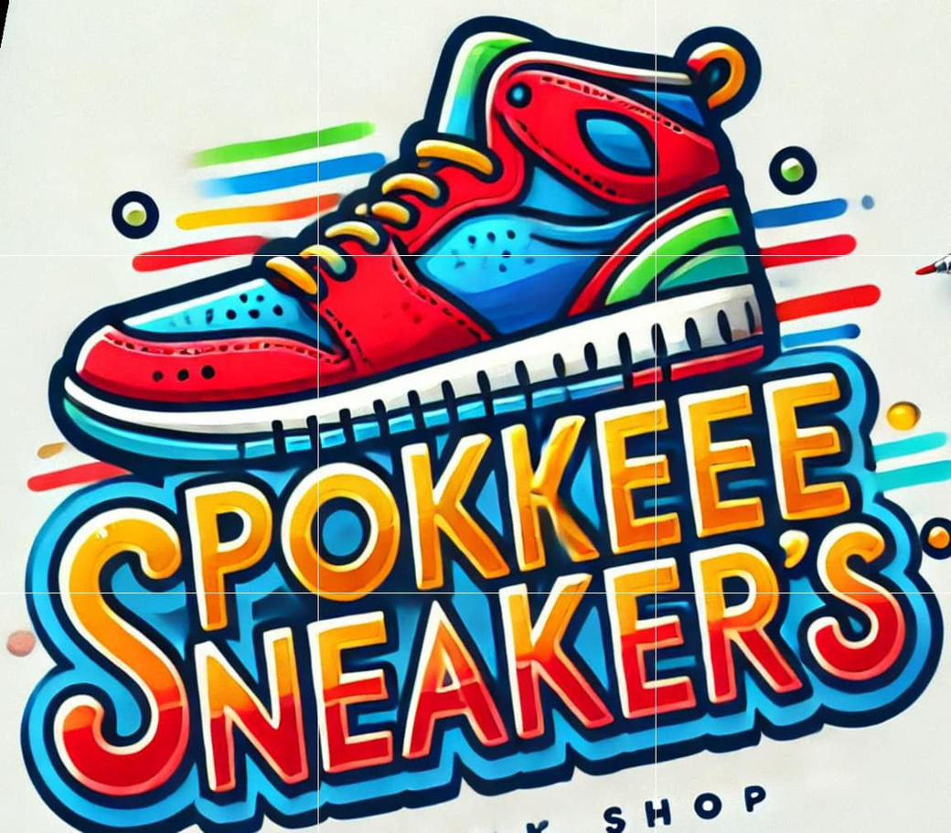
WELCOME

Slide 2




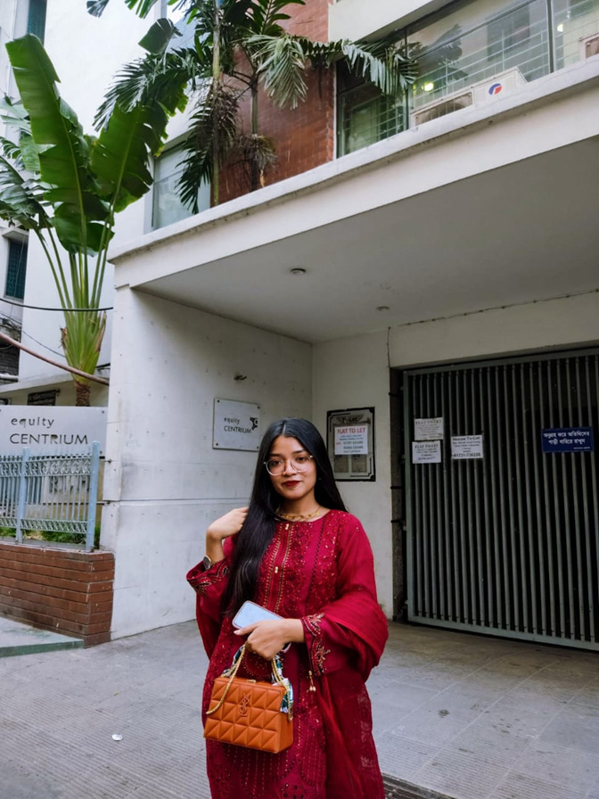
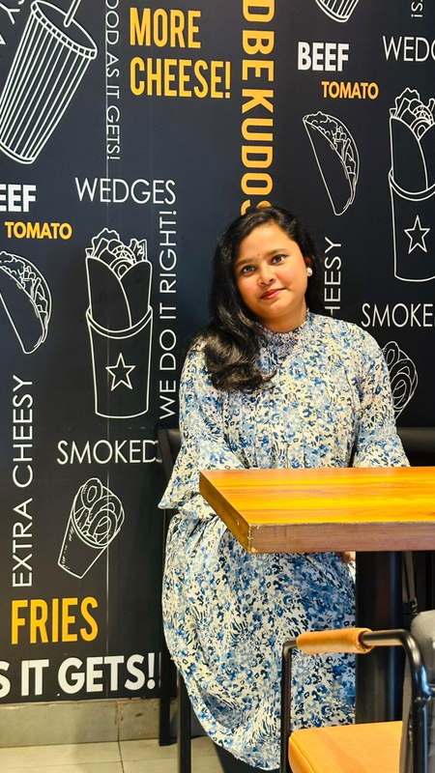

Presented
by
Samia Nasrin
Refazul Hoque
Sifat Nur
Binti Das

Slide 3







Introduction
An online sneakers ordering Platform
User-Friendly Interface
Admin Management Features

Slide 4

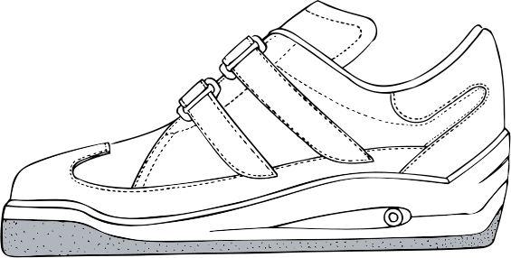
Project Organization
Hardware Software Requirement
System Architecture
Class Diagram
Project Demonstration
Testing

Slide 5


Requirement
Hardware
Software
Computer
Visual Studio Code
Internet
Xamp
Composer

Slide 6

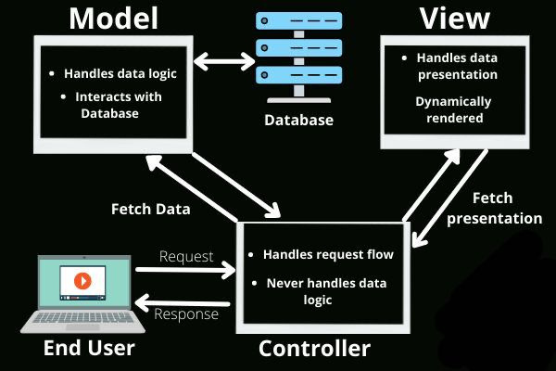


System Architecture

Slide 7
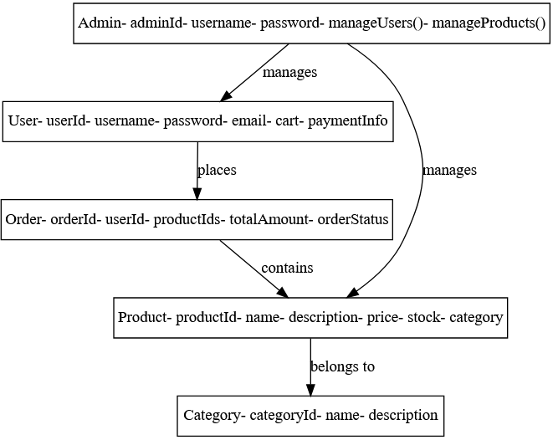
Class Diagram

Slide 8
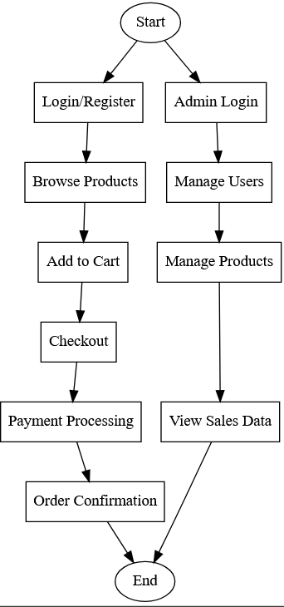
Demonstration

Slide 9

User
Section
Testing

Slide 10
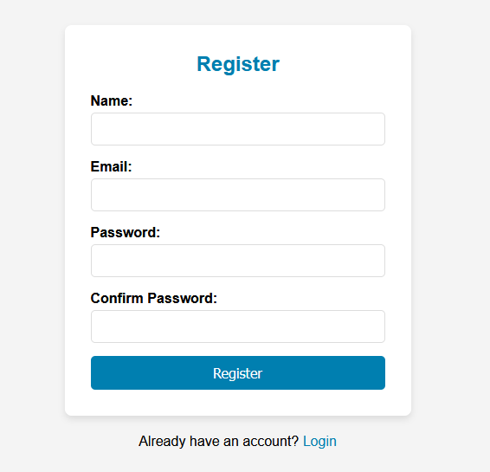
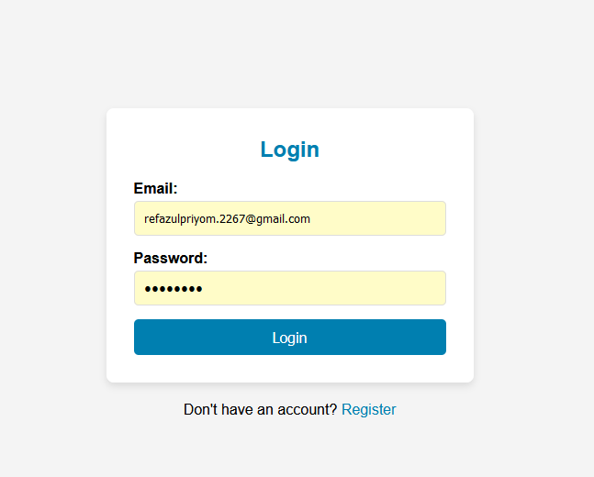
Register
Login

Slide 11
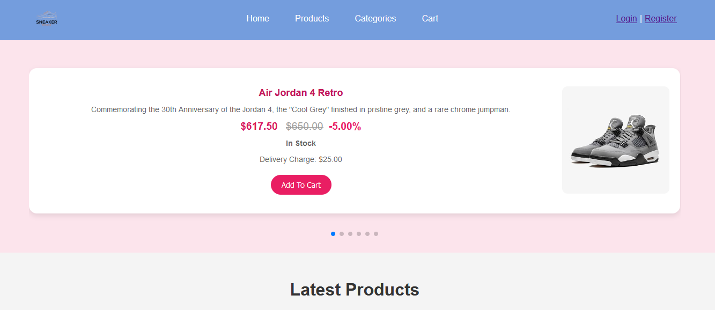
Home

Slide 12
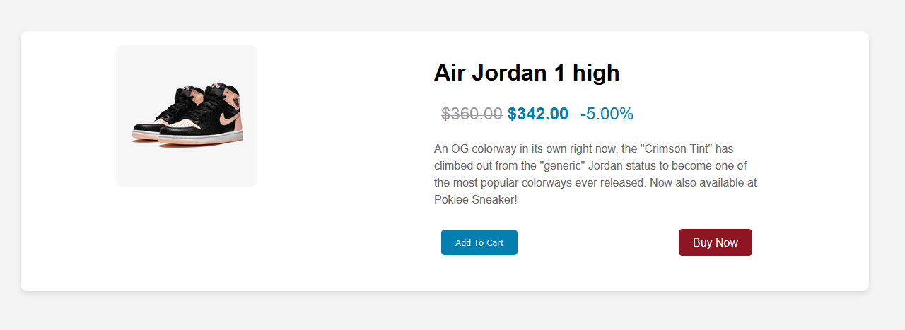
Product

Slide 13
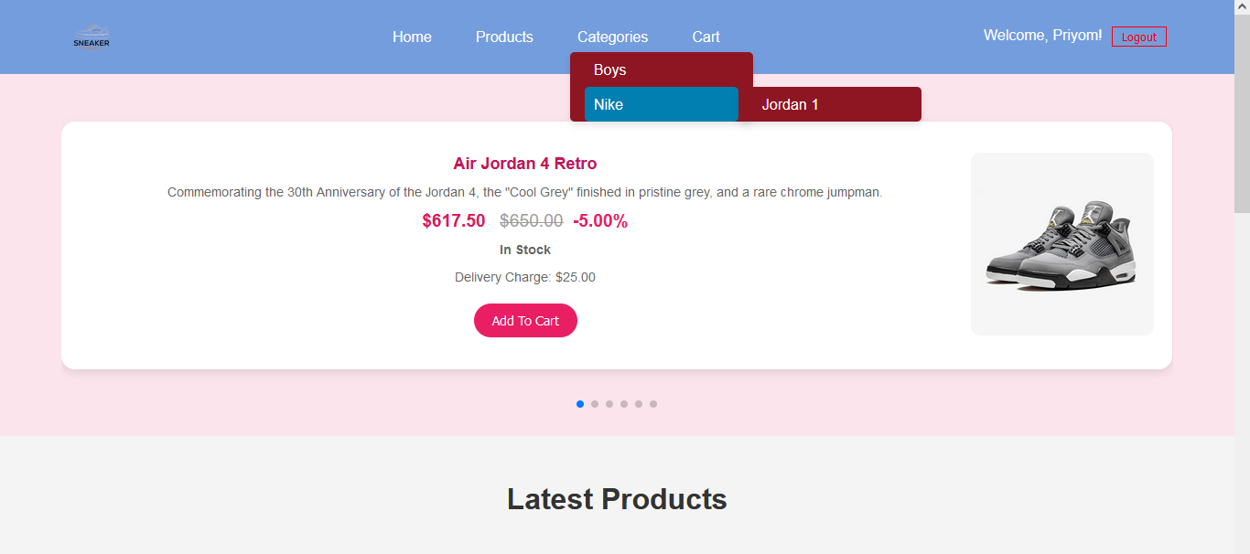
Catagorey

Slide 14
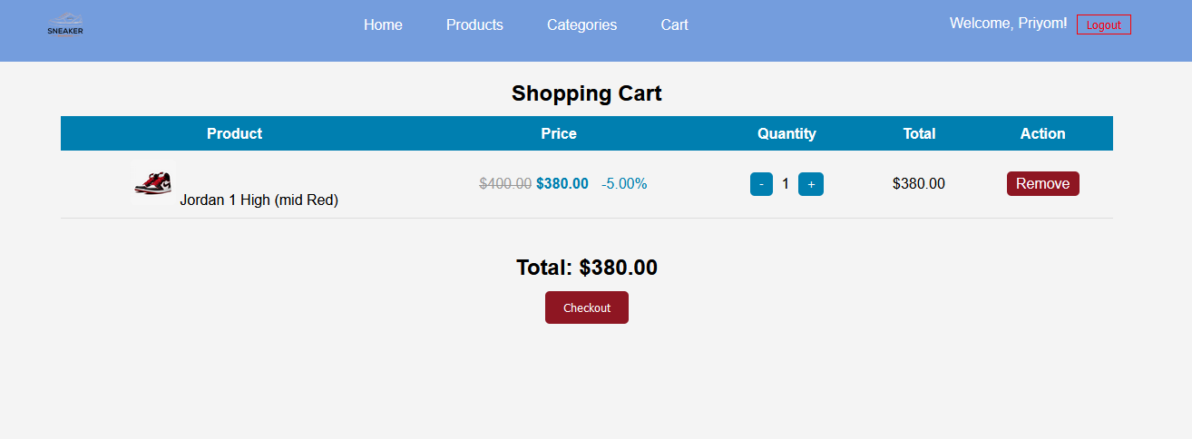
Cart

Slide 15
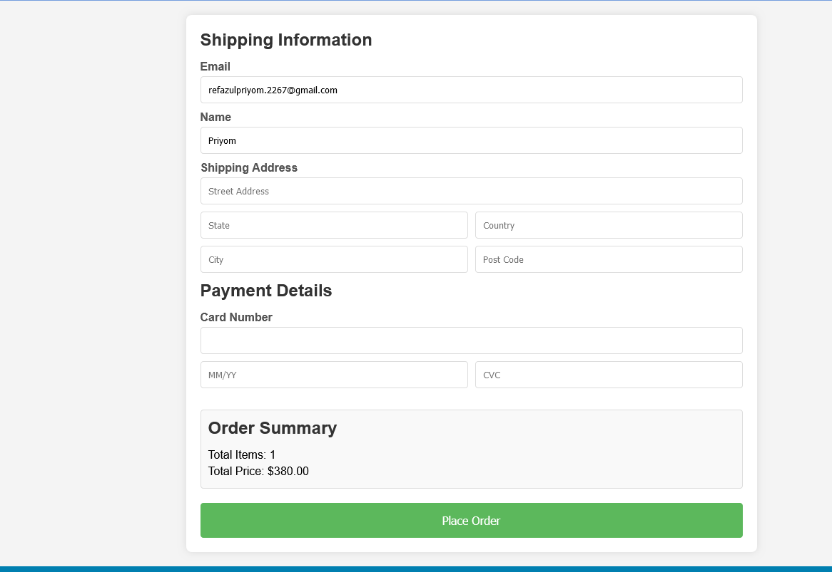
Payment

Slide 16

Admin
Section
Testing

Slide 17
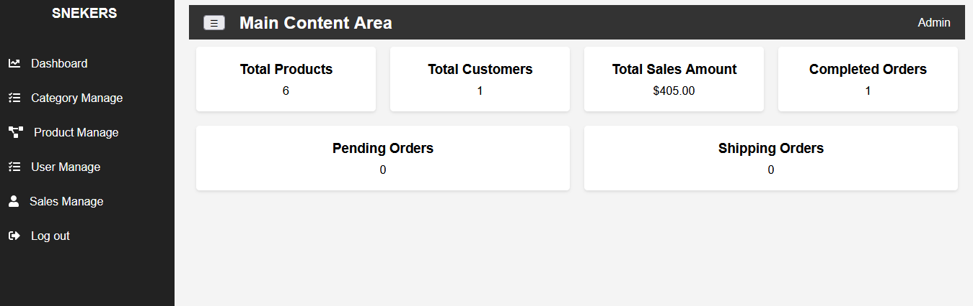
Dashboard

Slide 18
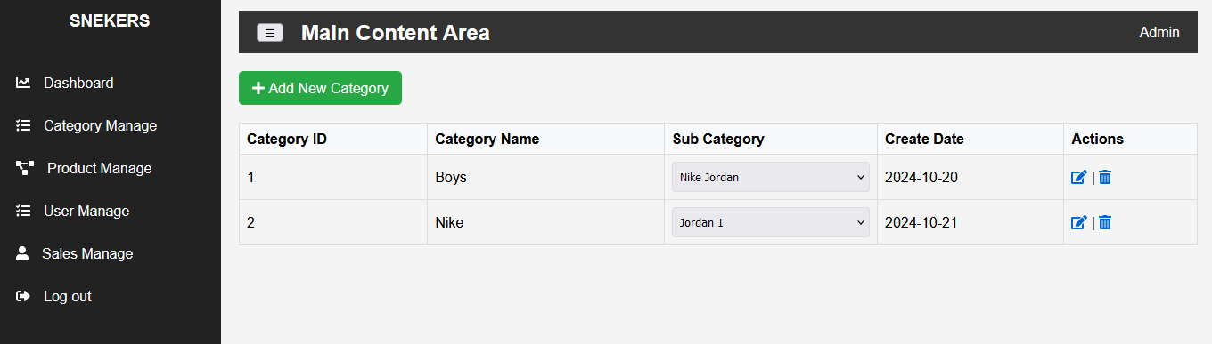
Catagorey Management

Slide 19
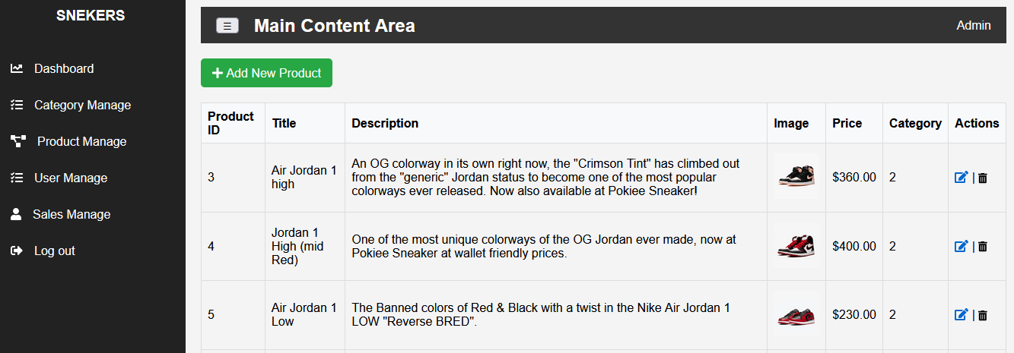
Product Management

Slide 20
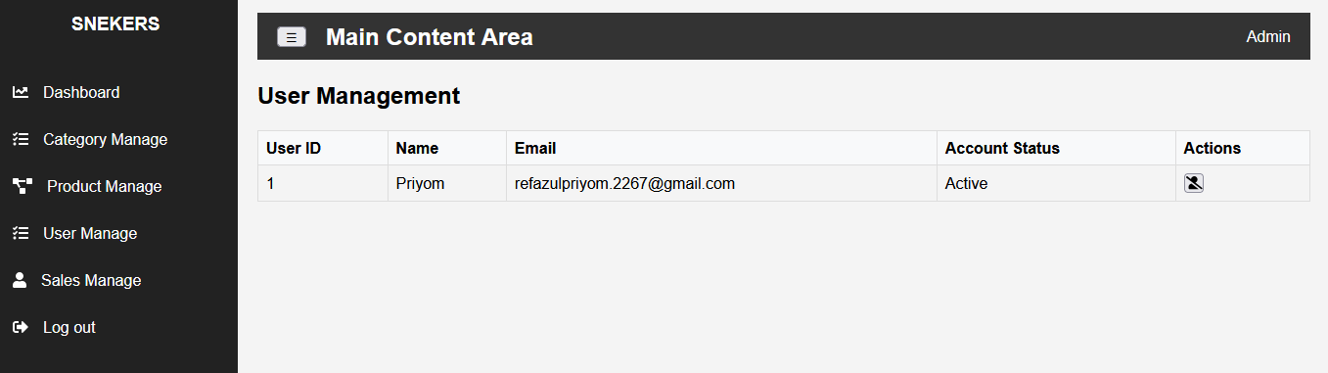
User Management

Slide 21
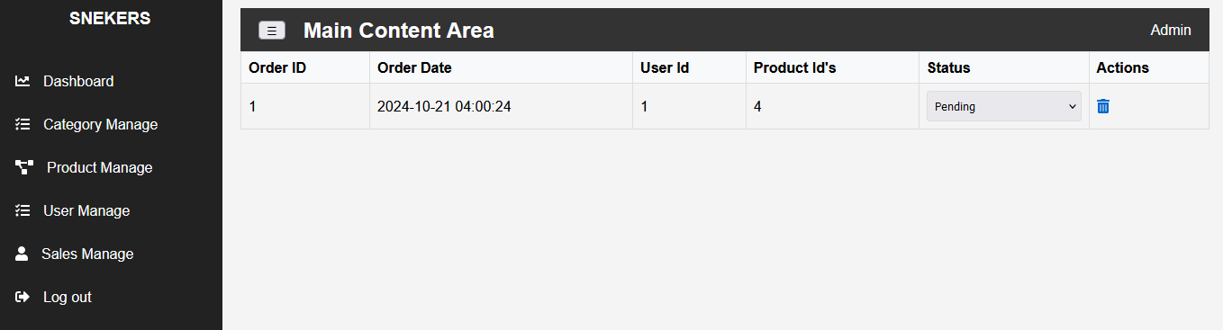
Sales Management

Slide 22
Limitation
Payment System
No Advanced Search Filters
Scalability Challenges
No Email Verification

Slide 23
Conclusion
In conclusion, Pokiee Sneakers successfully provides an efficient and user-friendly online platform for sneaker shopping, combining secure transactions with a comprehensive admin management system. While the project meets its initial goals, there is significant potential for future improvements, such as integrating more payment gateways and enhancing scalability to accommodate a growing user base.

Slide 24

Project Contribution
Refazul Hoque(2267)
Admin Section Backend, Frontend
Samia Nasrin(2259)
User Section Beckend
Sifat Nur(2282)
Admin Section Frontend
Binti Das(2311)
Database

Slide 25


